Slide 1
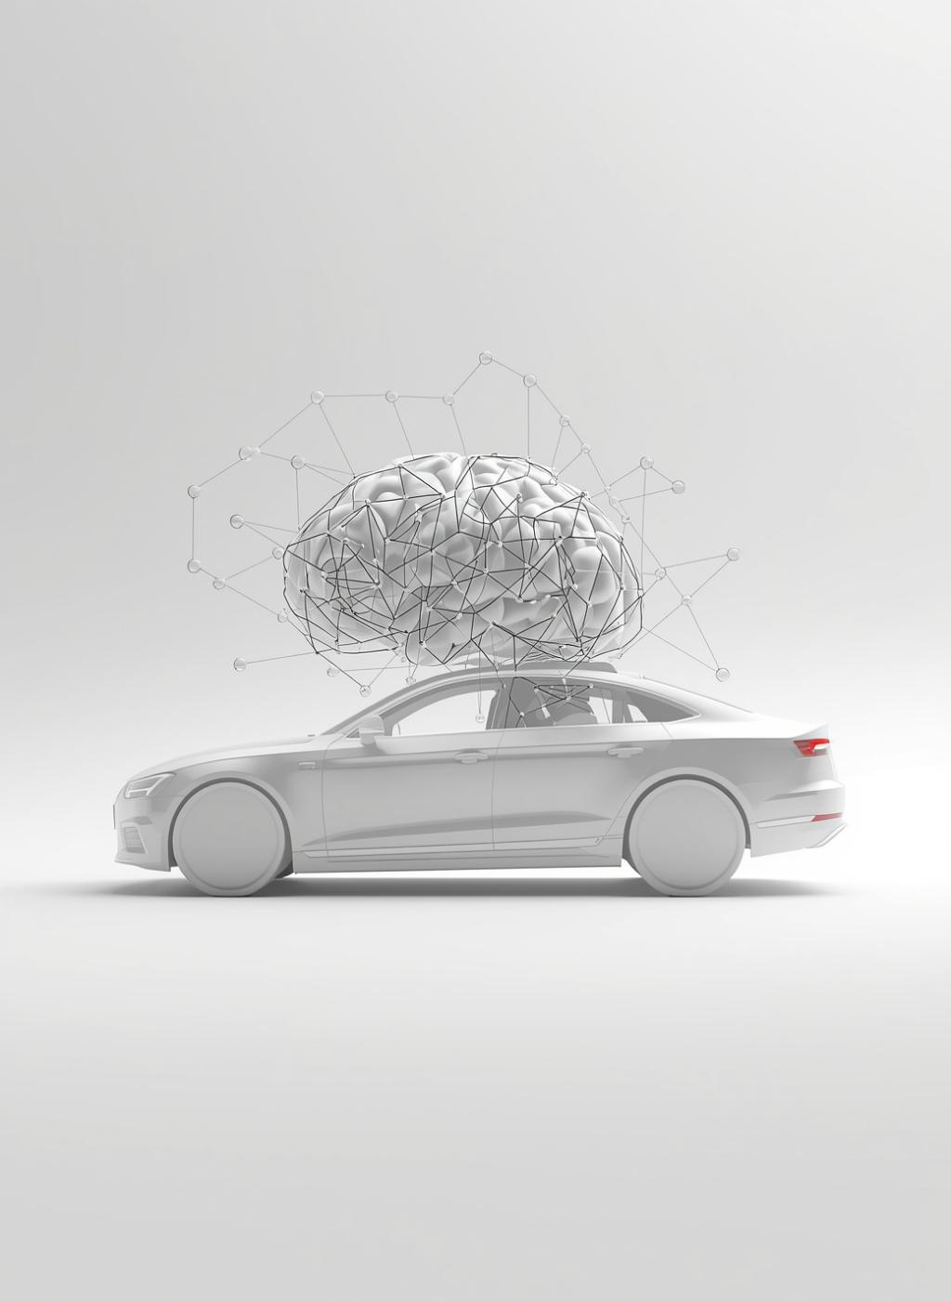
AI-Powered Driver Drowsiness Detection and Rescue System

Slide 2
Project Abstract
The rapid expansion of global road transportation and increasing vehicle density have intensified the need for autonomous safety systems to detect accidents and reduce response time. This project presents a real-time Automatic Vehicle Accident Detection and Rescue System designed to identify sudden impacts or abnormal vehicle movements using sensors. The system immediately activates a buzzer, displays alerts on an LCD, and sends notifications to enable quick emergency response and enhance road safety.

Slide 3


Team Overview
M. Naga Chaitanya Reddy (22HT1A0593)
Team Lead
K. Himabindu (22HT1A0576)
N. Harsha Vardhan Rao (22HT1A05A4)
P. Bunny (22HT1A05B2)

Slide 4
Introduction
Road accidents caused by driver fatigue are a critical issue that necessitates real-time monitoring and detection systems.

Slide 5
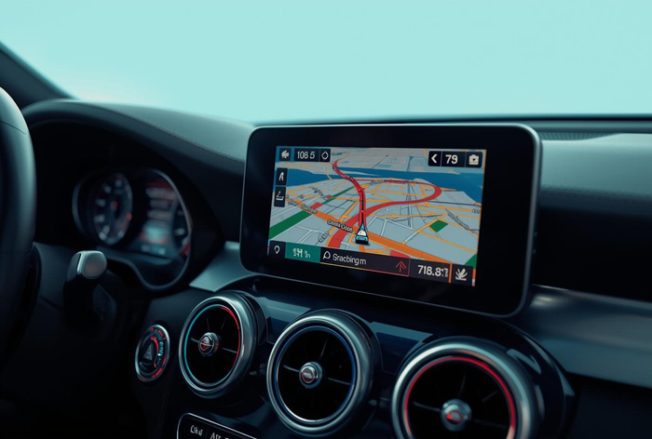
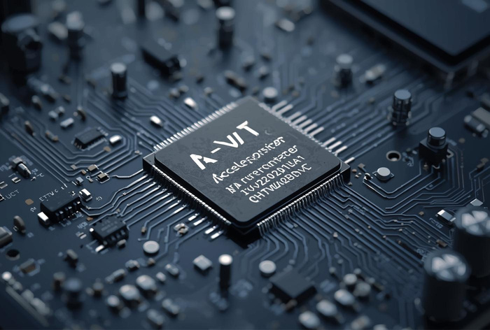
Existing System Limitations
GPS Tracking
Relies on location data but lacks drowsiness monitoring capability.
Accelerometer Use
Measures motion but does not provide driver fatigue detection.

Slide 6
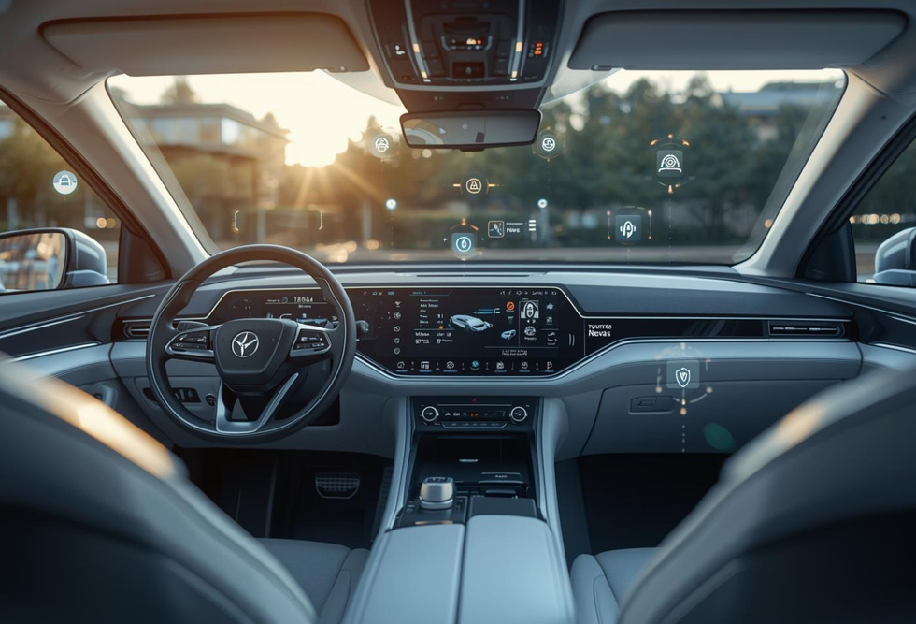
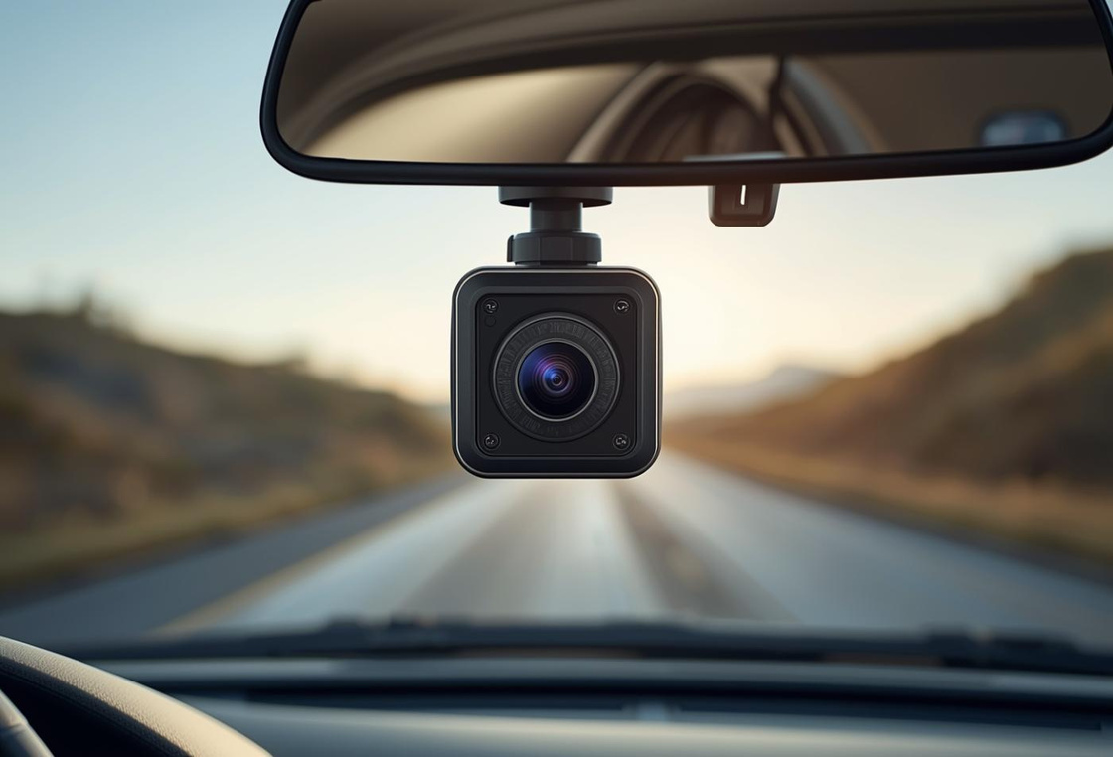
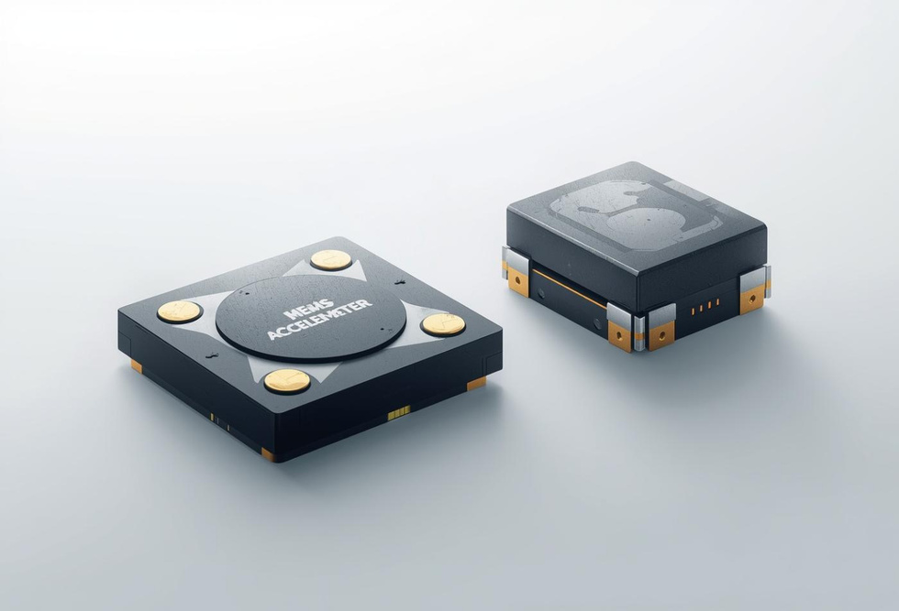
Proposed System
AI-Powered Driver Monitoring System
Real-Time Eye Detection for Alertness
Advanced Sensor Technologies for Safety

Slide 7
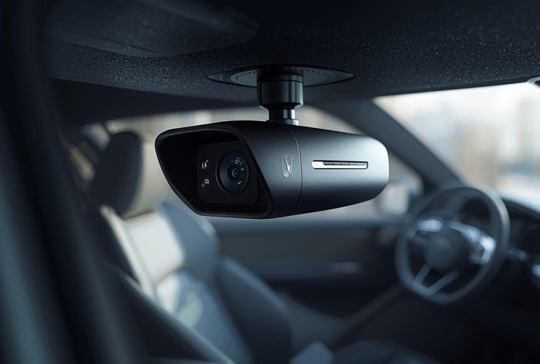

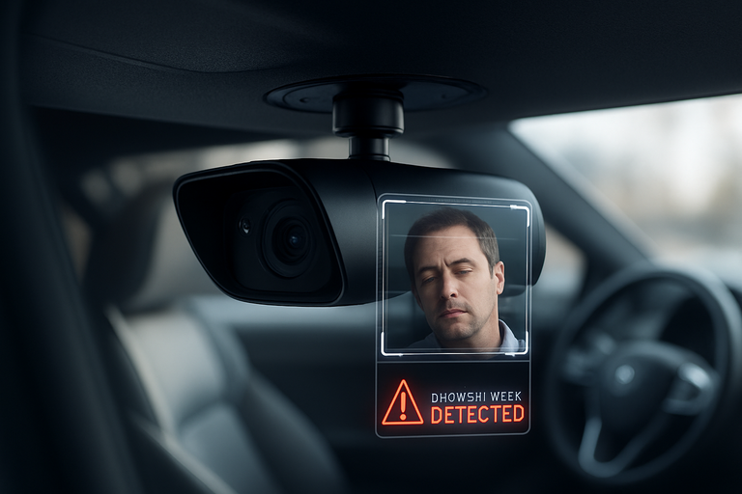
Project Overview
Video Acquisition
Captures real-time footage to monitor driver behavior and alert drowsiness.
Drowsiness detection & Alert generation
Continuously records the driver’s face to analyze eye activity and head movements.
Image Preprocessing
Applies techniques to enhance video quality and prepare for analysis.

Slide 8
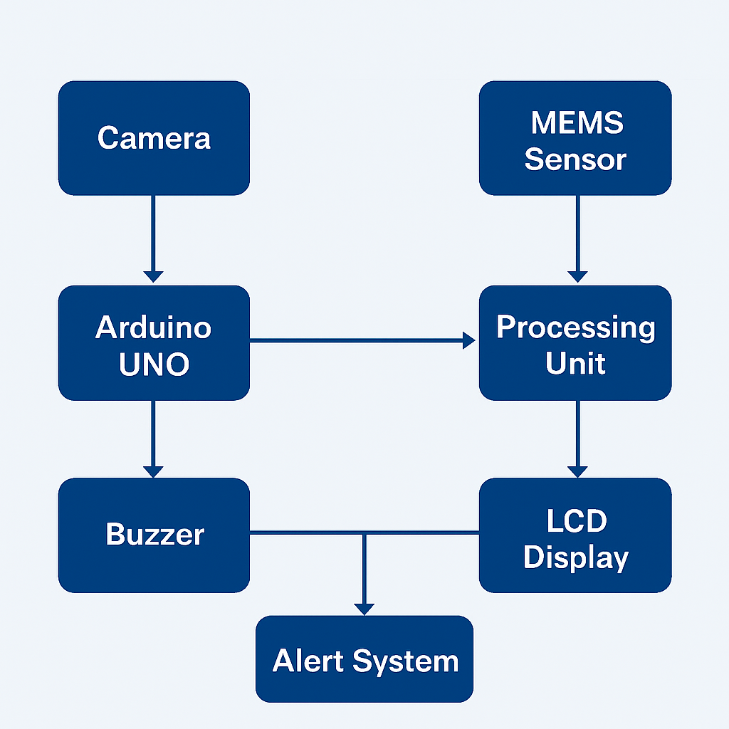
System Overview
Architecture Diagram
The system architecture shows how data flows between the components to detect accidents and trigger alerts. The camera captures real-time information and sends it to the Arduino Uno, while the MEMS sensor provides motion and impact data to the processing unit. The processing unit analyzes this data and displays the results on an LCD screen. If an accident is detected, the buzzer and alert system are activated to notify people and initiate emergency response.

Slide 9
Implementation of the Smart System
Continuous Monitoring
Sensor Integration
The system continuously monitors the driver’s behavior using an onboard camera to detect signs of drowsiness.
Data is collected from MEMS accelerometer and ultrasonic sensors to assess vehicle status and surroundings in real-time.
AI Processing
Alert Generation
AI algorithms analyze input data to identify drowsiness indicators and potential accident scenarios for immediate alerts.
Alerts are triggered instantly upon detecting drowsiness or an accident, ensuring rapid response from emergency services.

Slide 10
Essential Hardware Components for System
Arduino UNO
MEMS Accelerometer
A versatile microcontroller used for processing sensor data and executing program logic in real-time.
Measures vehicle acceleration and detects sudden movements, crucial for identifying potential accidents.
Ultrasonic Sensor
Camera Module
Detects obstacles in the vehicle's path, enhancing safety by preventing collisions through alert mechanisms.
Captures real-time video for driver monitoring, enabling drowsiness detection through advanced image processing techniques.
LCD Display
Buzzer
Displays real-time system status and accident information.
Generates an immediate audible alert during accidents or emergencies, ensuring quick attention and response.

Slide 11
Software Requirements for the Project
Arduino IDE
Embedded C
The primary tool for programming the Arduino microcontroller, facilitating efficient development and debugging of the code.
The programming language used for the implementation of algorithms that control hardware functionality and processing.
Computer Vision & AI Libraries
IoT Bot Application
Algorithms enabling real-time face and eye detection to assess driver drowsiness and enhance monitoring accuracy.
IoT-enabled real-time monitoring and instant alert system for enhanced vehicle safety and remote emergency response.

Slide 12
Conclusion
This project aims to enhance road safety through effective driver monitoring and accident detection.

Slide 13
Thank you!
For questions, reach out at: m.chaitanyareddy999@gmail.com

